Slide 1
Generalized Linear Mixed Model
AMS 573 GROUP 1 SPRING 2020
Weichuan Deng, Christina Hartnett, Julia Vasile, Kang Pu and Shih Hsuan Lu
Notes:
we generalize this is more like if you if you're familiar with a mix model, you know, the coefficients beta in our house we treated as fix effects. So the beta is is indeed is is is is just fixed the beta ****can also be random****. So what you have in the beta can be both fixed on the random then this recorded mixed model. So gentlemen media mix model will be a generalization from the linear model

Slide 2
Content
Background
Introduction
Estimation
Description of the data
Summary

Slide 3
Background

Slide 4

Background:
Linear Models:
Linear models are used to describe continuous quantitative dependent variables as a function of one or more quantitative or qualitative predictor variables.
They help us to predict behaviors in complex systems. The general form of the model is:
This describes our relationship between y and the predictors, where y is the dependent or response variable. ϵ represents some error terms.
Notes:
In order to understand Generalized Linear Mixed Models we first need to understand some underlying concepts.
(where β represents linear parameter estimates to be computed and ϵ represents the error terms.)
https://www.mathworks.com/discovery/linear-model.html

Slide 5
Background:
A Generalized Linear Model is a class of models which includes models such as ANOVA and ordinary regression. These can be either continuous responses or discrete responses, such as categorical data.
GLMs consists of three components: The Random Component , the Systematic Component and the Link Function .
Notes:
CHAPTER 3 TEXTBOOK

Slide 6
Background:
Random Component, Systematic Component and Link Function
The Random Component will identify/ specify Y (response variable) and then will select the probability distribution it has.
The Systematic Component will identify/ specify the explanatory variables (Xi’s) and the linear combination they are fit to.
The Link Function will connect systematic and random components. It specifies the function g() that will relate our expected value (mean) to the linear predictor
g(μ) = α + β1(x1) +···+ βk(xk)
Notes:
α + β1x1 +···+ βkxk, α is the intercept
LINK: The link function specifies a function of the expected value (mean) of Y , which the GLM relates to the explanatory variables through a prediction equation having linear form.

Slide 7
Linear Mixed Model

Slide 8
Linear Mixed Model
Linear mixed are an extension from simple linear models, this allows us to now include fixed and random effects
Linear mixed models are used to analyze data that is non independent, multilevel/hierarchical, longitudinal, or correlated.
Notes:
https://stats.idre.ucla.edu/other/mult-pkg/introduction-to-linear-mixed-models/

Slide 9
Generalized Linear Mixed Model

Slide 10
Introduction:
The generalized linear mixed model will extend the Generalized Linear Model to incorporate random effects. It can also permit fixed effects in the linear predictor.
We can also think of it as an extension of Linear Mixed Model to allow our response variables to come from different distributions

Slide 11
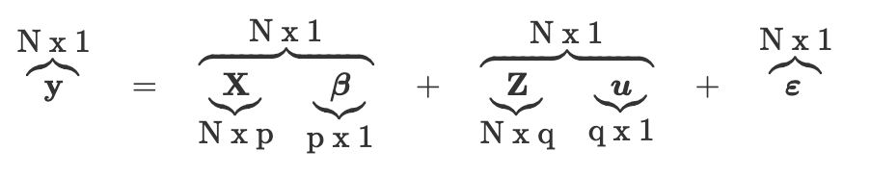
Generalized Linear Mixed Model
The General form is:
Source: https://stats.idre.ucla.edu/other/mult-pkg/introduction-to-generalized-linear-mixed-models/

Slide 12
Random Effects
Random-effects models are statistical models in which some of the parameters, (effects) that define systematic components of the model, exhibit some form of random variation.
A “group” effect is random if we can think of the levels we observe in that group to be samples from a larger population.
Ex: medical centers, Doctor ID Card(our data)
Notes:
repeated measures, where more than one (identical) measurement is taken on the same individual.
In random effects model, the observations are no longer independent (even if ε’s are independent).
if collecting data from different medical centers, “center” might be thought of as random

Slide 13

Doctor example
An example data set in which generalized linear mixed models can be used given by UCLA institute for digital research and education statistical consulting is given below:
Given 407 doctors and 8525 patients, each doctor has ni patients
We have 6 fixed effect explanatory variables (X)
Random intercept for each doctor
Fixed intercept
Age (in years)
Married (0 = no, 1 = yes)
Sex (0 = female, 1 = male)
Red Blood Cell (RBC) count
White Blood Cell (WBC) count
Our response variable, Y, will be mobility score.
Example credit: UCLA institute for digital research and education statistical consulting

Slide 14
Estimation

Slide 15
Estimation
Parameters can be estimated in many different ways, three common ways are:
Quasi-likelihood
Maximum Likelihood
Monte Carlo EM
Monte Carlo Likelihood Estimate
We need to use these methods or estimation because there are not closed form solutions for Generalized Linear Mixed Models
Notes:
https://stats.idre.ucla.edu/other/mult-pkg/introduction-to-generalized-linear-mixed-models/

Slide 16
Summary of Estimation Methods
Quasi likelihood:
Approximate likelihood of GLMM function by maximizing penalized quasi-likelihood function
Numerical Integration:
Approximates likelihood and estimates MLE
Monte Carlo EM:
Maximum likelihood for models with missing data
Monte Carlo Likelihood Approximation:
Approximates likelihood function, helpful for models with non normal densities

Slide 17
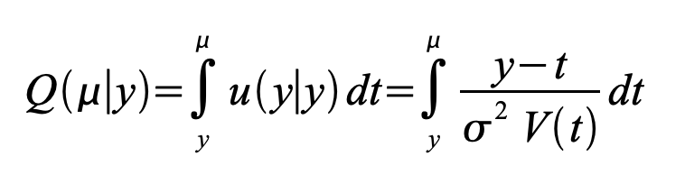
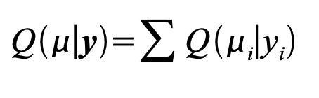
Quasi Likelihood
Quasi-Likelihood is a method to approximate the likelihood of the GLMM. It is often associated with estimating a parameter and prediction of random effects. It is often used for count or binary data, when there is overdispersion. Penalized Quasi-Likelihood does not produce Maximum Likelihood Estimates, it maximizes the function known as the penalized quasi-likelihood. The usual approach is to approximate the the log likelihood using second order Taylor polynomial. As we continue to approximate, we further simplify it and can yield the penalized quasi-likelihood. This identifies a relationship between the mean and variance. It creates a function of the variance in terms of the mean.
The quasi-likelihood function is:
where
Notes:
https://pdfs.semanticscholar.org/4f3a/14354001a9b884a2a20633a226d7ef29e126.pdf
http://www.maths.usyd.edu.au/u/jchan/GLM/QuasiLikelihood.pdf

Slide 18
Numerical Integration
Numerical Integration Numerical integration produces an approximation to the likelihood. The approximation contains deterministic (rather than Monte Carlo) error. As a result, maximizing the likelihood approximation produces estimates of MLEs. Because numerical integration produces an approximation to the entire likelihood, it enables all types of frequentist likelihood-based inference. The limitation of numerical integration is that it is viable for low-dimensional integrals only.
Notes:
https://pdfs.semanticscholar.org/4f3a/14354001a9b884a2a20633a226d7ef29e126.pdf

Slide 19
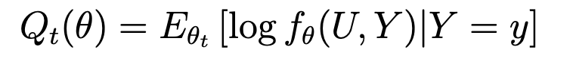
Monte Carlo EM
The Monte Carlo EM algorithm performs maximum likelihood for models with missing data. There are two components to the EM algorithm.
The two steps it iterates between are:
E-Step: Computes the log-likelihood of a given data set using estimated parameters
M-Step: Maximizes parameter estimates (Maximizes what was found in E-Step): Qt(θ)
Where Qt(θ) is:
Notes:
https://pdfs.semanticscholar.org/4f3a/14354001a9b884a2a20633a226d7ef29e126.pdf
http://www.columbia.edu/~mh2078/MachineLearningORFE/EM_Algorithm.pdf

Slide 20
Monte Carlo Likelihood Approximation
Monte Carlo Likelihood Approximation approximates the entire likelihood function. It is helpful for models with non normal densities. Focusing on MCLA for GLMMs with random effects. MCLA is powerful as it enables any type of likelihood-based inference. The accuracy of the likelihood approximation can be improved when we increase the size of the Monte Carlo sample.
Notes:
https://pdfs.semanticscholar.org/4f3a/14354001a9b884a2a20633a226d7ef29e126.pdf
http://www.columbia.edu/~mh2078/MachineLearningORFE/EM_Algorithm.pdf

Slide 21
Issues with the different Estimations
Quasi Likelihood
Often has bias associated with it when using binary correlated data, which is why they are not our preferred estimator for final models
Numerical Integration
it is a useful method when a high degree of accuracy is desired but performs poorly in high dimensional spaces, for large datasets, or if speed is a concern.
EM algorithm
Relies on the maximum likelihood and will only evaluate at certain points and not the whole likelihood function
Complete separation
The outcome variable separate a predictor variable completely, leading perfect prediction by the predictor variable
Notes:
https://stats.idre.ucla.edu/other/mult-pkg/introduction-to-generalized-linear-mixed-models/

Slide 22
Advantages
Generalized linear mixed models provide more flexibility in developing models for data because it allows for deviations from usual linear mixed model assumptions
Because of its flexibility, analysts can focus more on developing a model without having to manipulate data to fit a more restricted class of models
GLMM’s a better method for analyzing nonnormal data with random effects, as they combine properties from linear mixed models and generalized linear models
Notes:
https://pdfs.semanticscholar.org/4f1c/417fb9bac04309f0ba9b0ec44d5ef51e36aa.pdf
http://byrneslab.net/classes/biol607/readings/Bolker_et_al_2009_TREE.pdf

Slide 23
Potential Disadvantages
GLMM’s can be challenging to implement and check assumptions
Generally one may select a simple model to appropriately model the data
Estimation of parameters using maximum likelihood approaches can be computationally expensive or infeasible
There are various methods for GLMM approximation but some, such as PQL, may introduce bias in parameter estimates if the standard deviations for the random effects are larger
Common link functions may not be guaranteed to accurately represent the relationship between explanatory variables and outcomes, and checking the appropriateness of link functions can becomes more complicated with complex models
Comparing predicted values and outcomes is one approach to this issue
Notes:
https://pdfs.semanticscholar.org/4f1c/417fb9bac04309f0ba9b0ec44d5ef51e36aa.pdf
http://byrneslab.net/classes/biol607/readings/Bolker_et_al_2009_TREE.pdf

Slide 24
Description of HDP Data

Slide 25
What we want to know
Whether a patient’s lung cancer goes into remission after treatment

Slide 26
Variables
Interleukin 6(IL6):it is a protein produced by various cells
Number of tumors(ntumors):This outcome is a count number of tumors that is right censored since the surgeons did not count beyond 9
Cancer stage(CancerStage): Four levels
Experience(Experience): Years in practice as a doctor
Doctor Identity Document(DID): Doctor ID Card

Slide 27
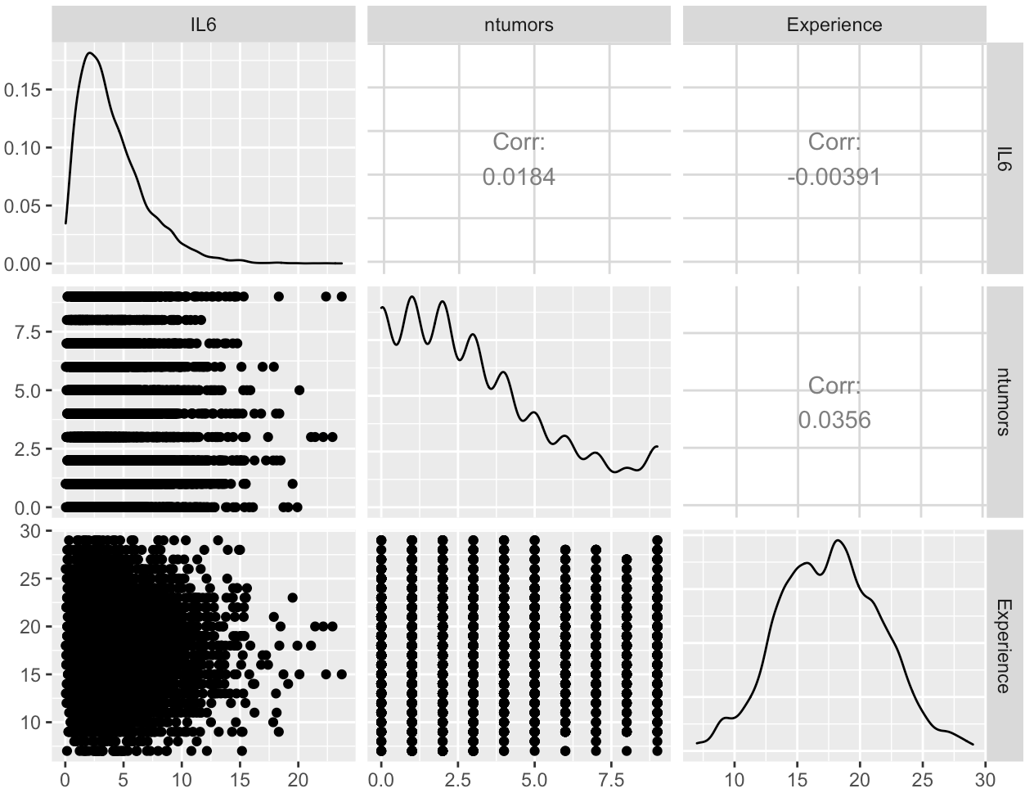
Data Processing
No strong linear relationship
Notes:
Since we want to know the relationship of the variables, we visualize the data to see whether the variables are independent or not. If they are independent, the estimate for one predictor should not change much when you enter another predictor

Slide 28
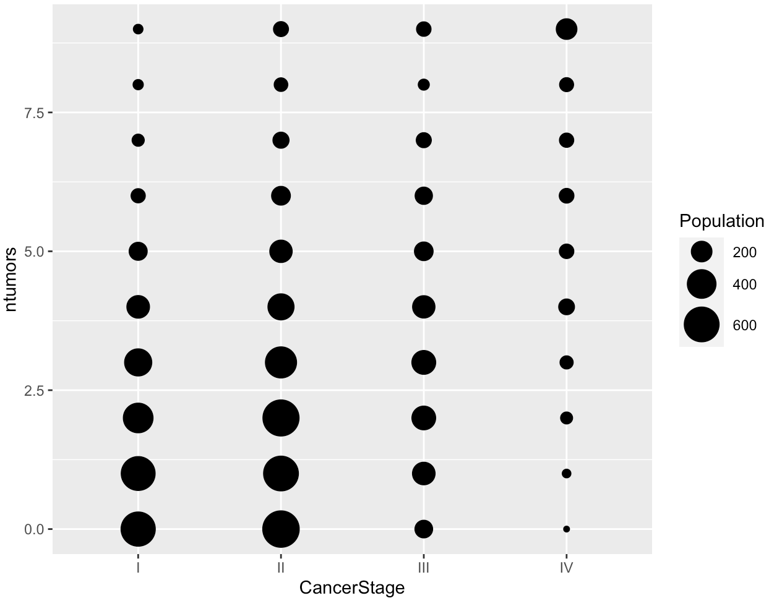
Data Processing
Number of tumors increasing
Sample size decreasing
Notes:
The bubble plots helps us to know the area of each bubble is proportional to the number of observations with those values.

Slide 29
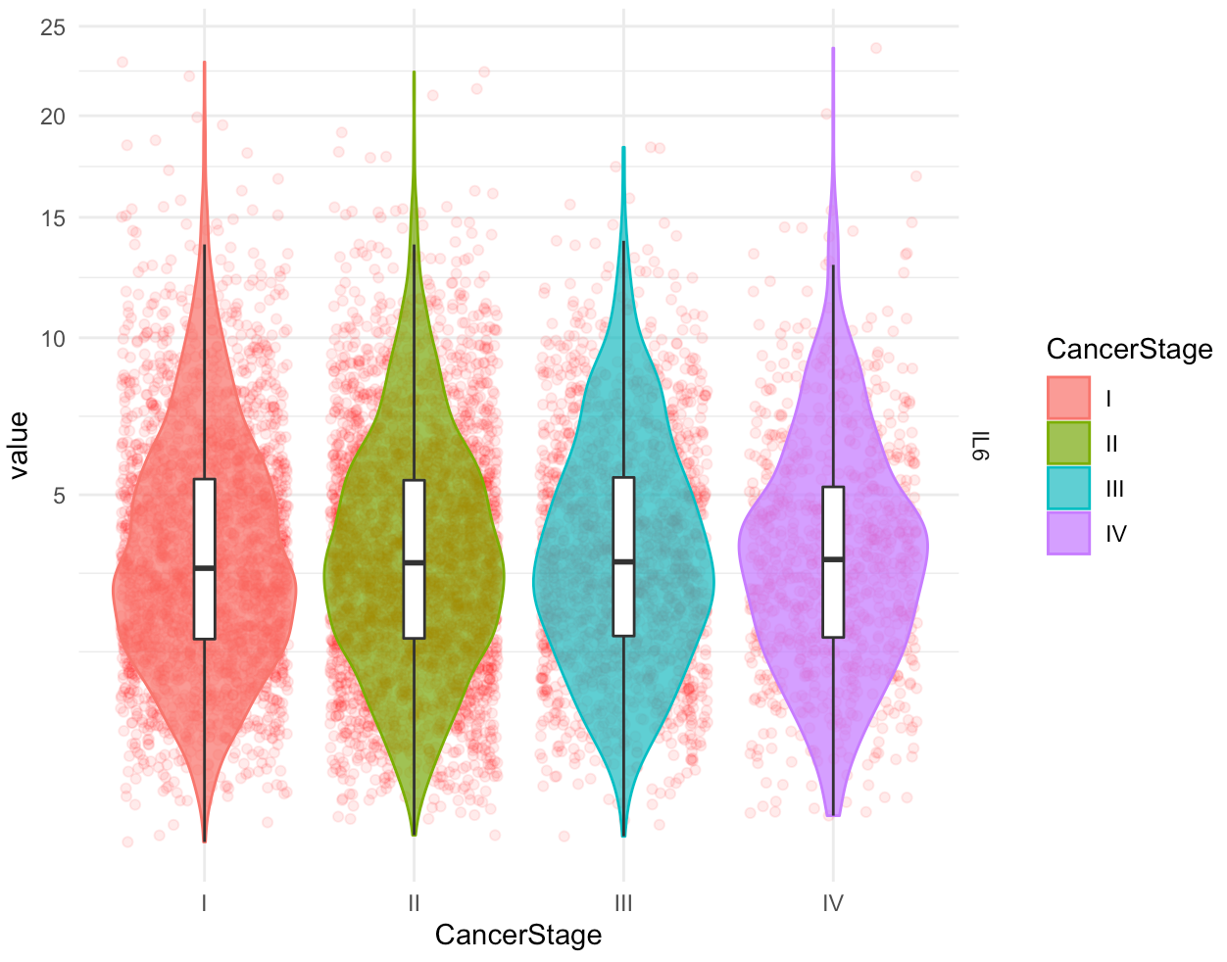
Data Processing
Distributions look fairly normal and symmetric
Notes:
Jittered dots is good to see the row data and we can see the sense of the distribution from the violin plots. Because both IL6 tend to have skewed distributions, we use a square root scale on the y axis.

Slide 30
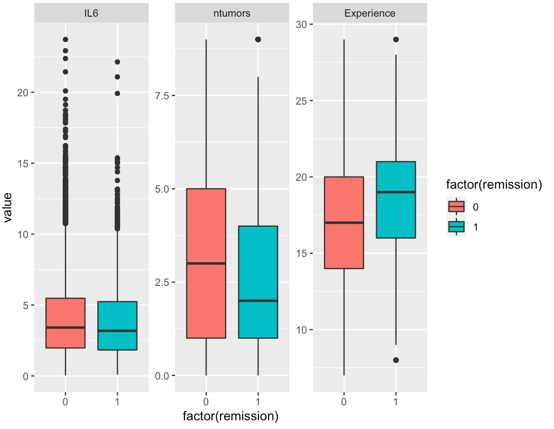
Data Processing
Remission
VS
Continuous Data
Notes:
look at the distribution of continuous variables at each level of the binary outcome.

Slide 31
Two Optimization For GLMM
Bound Optimization BY Quadratic Approximation(BOBYQA):
To solves bound constrained optimization problems without using derivatives of the objective function, which makes it a derivative-free algorithm
Nelder-Mead Method
The method is a commonly applied numerical method used to find the minimum or maximum of an objective function in a multidimensional space.
Notes:
Non linear data

Slide 32
Model Comparison
GLM: remission ~ IL6 + ntumors + CancerStage + Experience+DID
GLMM: remission ~ IL6 + CancerStage + ntumors + Experience +
(1 + ntumors | DID)

Slide 33
GLMM: remission ~ IL6 + CancerStage + ntumors + Experience +
(1 + ntumors | DID)
There may also be random variability across the doctors of those patients.
Random intercepts allow the outcome to be higher or lower for each doctor; random slopes allow fixed effects to vary for each doctor.

Slide 34
Evaluation Method
Cross-validation is mainly used in settings where the goal is prediction. After a model is trained in the training dataset and one wants to estimate how accurately a predictive model will perform test dataset. The goal of cross-validation is to test the model's ability to predict new data that was not used in estimating it
Training data
Testing data

Slide 35





Model Accuracy
For small sample: split ratio is 0.80(sample size = 500)
For large sample: split ratio is 0.90(sample size = 8525)

Slide 36
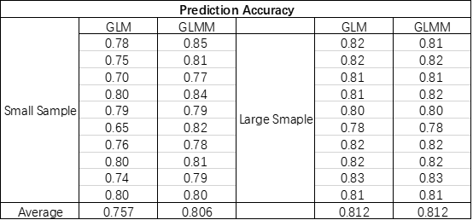
GLM-GLMM Model Comparison
GLMM Model has a higher accuracy when the sample size is relatively small
When the sample size is large, prediction accuracy of two models are similar

Slide 37
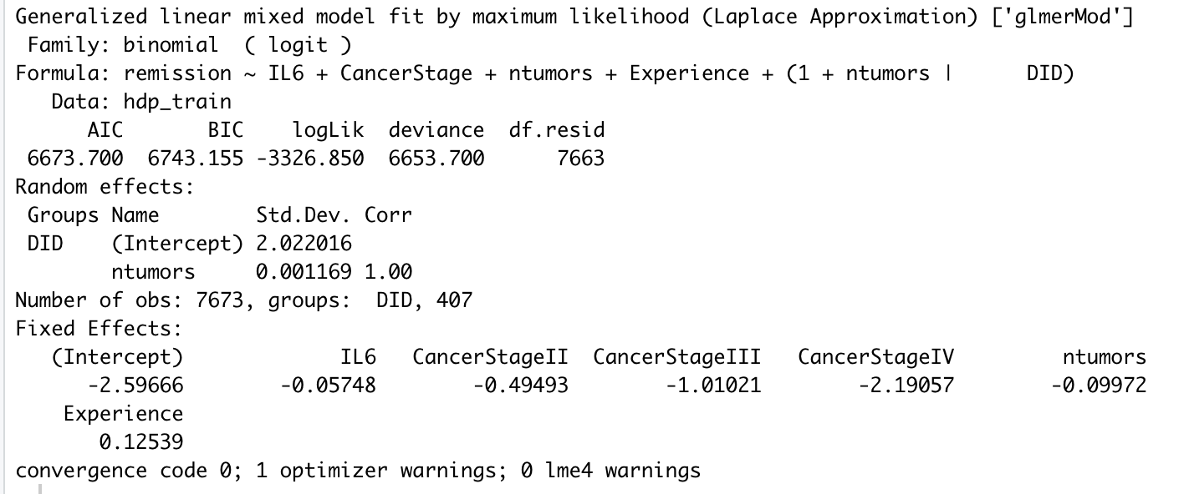
Result

Slide 38
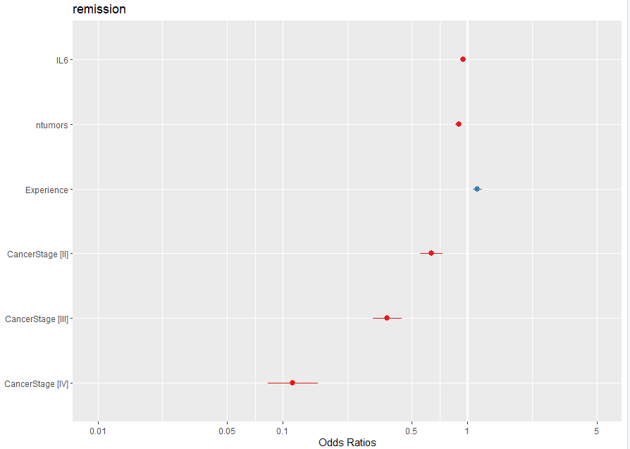
Odds for independent variables
Doctors with more experience are more likely to make the recession happen.
Remission rate: Cancerstage Ⅰ>Cancerstage Ⅱ>Cancerstage Ⅲ>Cancerstage Ⅳ

Slide 39
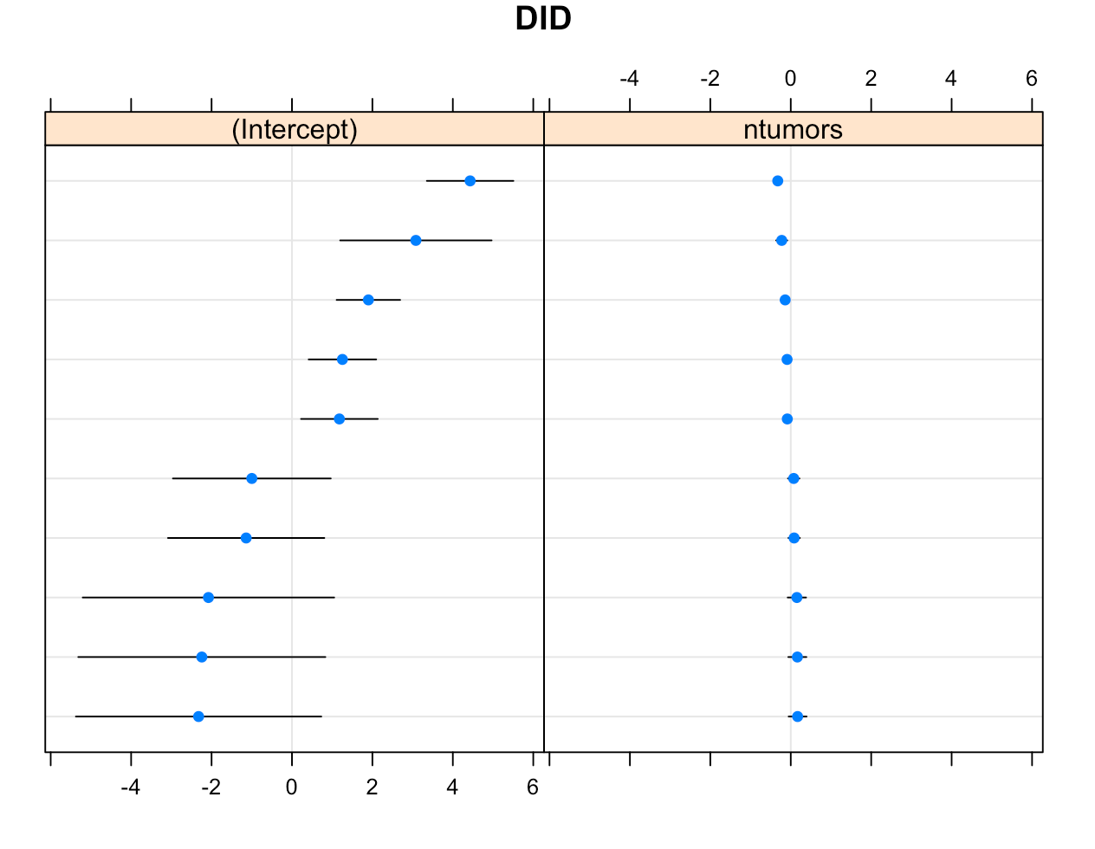
Random Effects
The random slopes are not obvious
The random intercepts are easily discovered

Slide 40
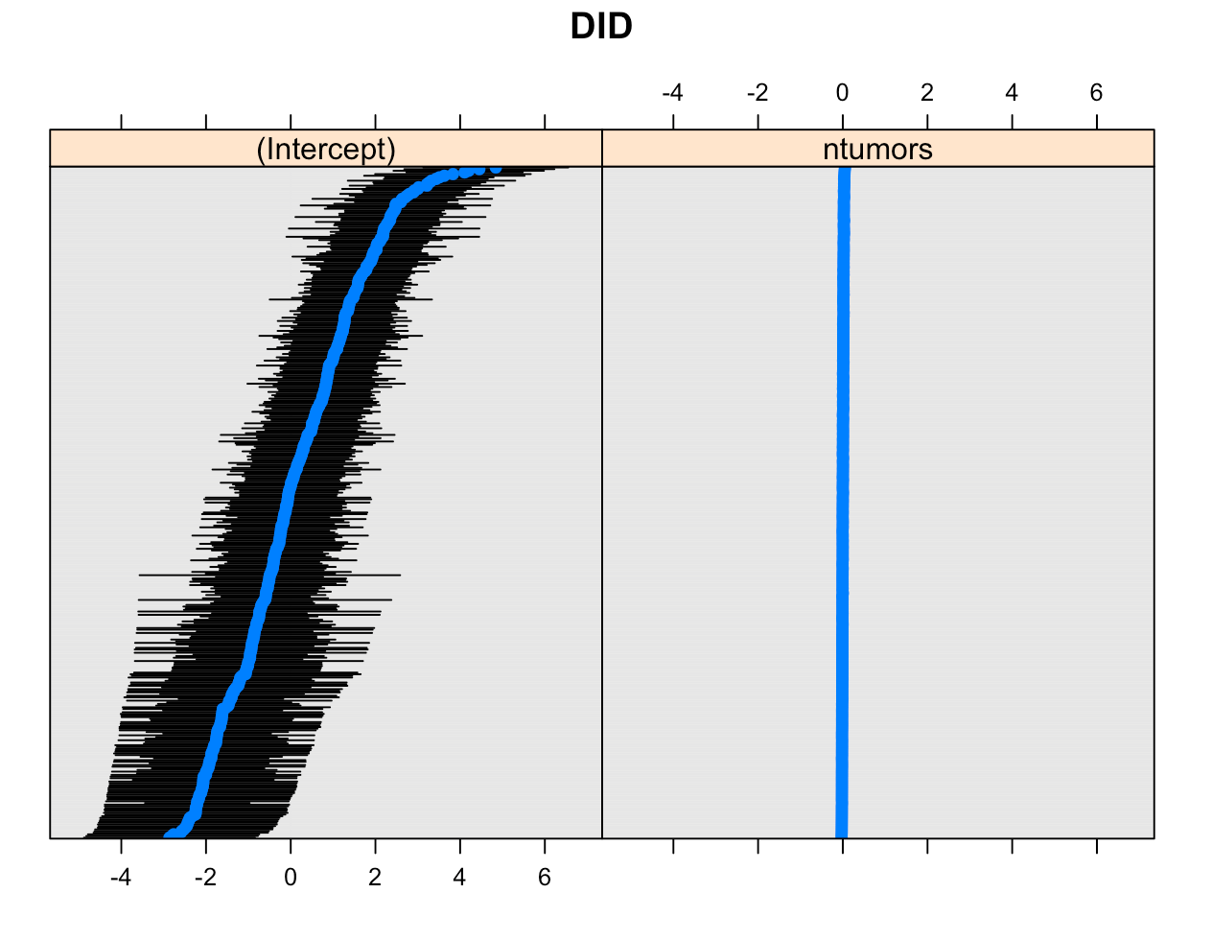
Random Effects
Full data is the same

Slide 41
Marginal Effect
Three types:
Average Marginal Effect(AME) Marginal Effect at the Mean(MEM)
Marginal effects at representative values(MER)
What we choose:AME To know the relationship between a dependent variable and an independent variable.
Notes:
AME:To find the AME, calculate the marginal effect of each variable x for each observation (taking into consideration any covariates). Then calculate the average.
MEM:This is very similar to the AME, the covariates are kept at their mean values
MER:The difference here is that you would choose representative values (i.e. values of interest in your experiment or study) for your covariates

Slide 42
Average Marginal Effect
Information of Ntumors
 | Min | Mean | Max
Ntumors | 0 | 3.066 | 9
0.00 0.09 0.18 0.27 0.36 ………… 8.73 8.82 8.91 9.00
100

Slide 43
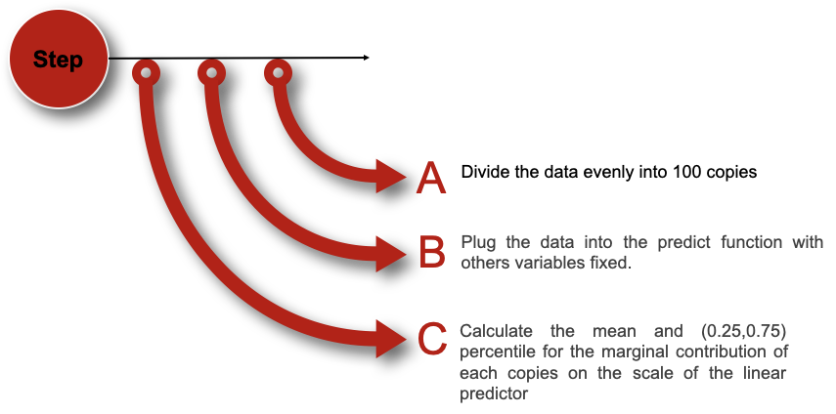
Average Marginal Effect
Notes:
followed by these steps, for example, in the frist copy, we let all of ntumor=0 and plug it into the predict function and other variables are fixed and get the first mean. Then we let all of the ntumor =1 in the second copy and plug it into the function replacing the original data of the variables ‘ntumor’ and get the second mean and so on. In the end, we will get 100 means and calculate the average mean.

Slide 44
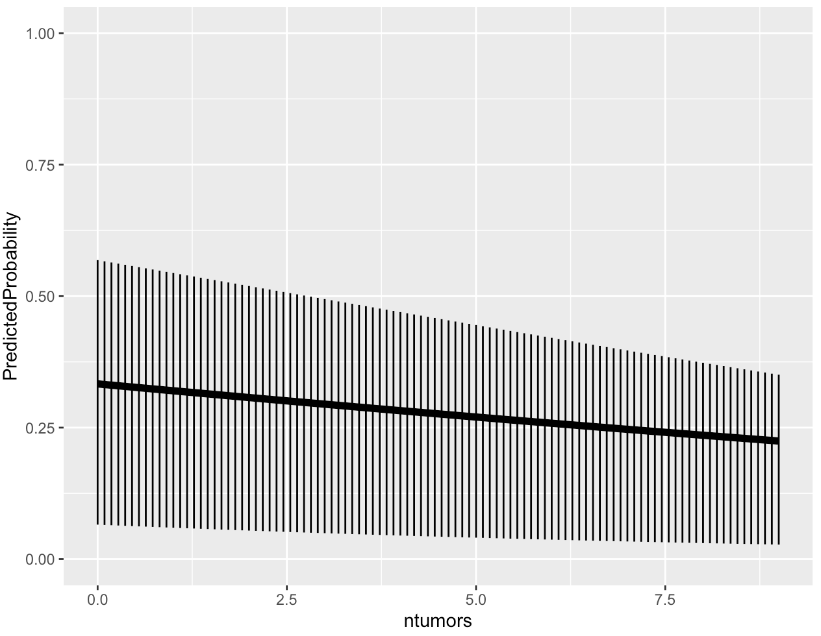
Marginal Effects
Number of tumors increasing
Predicted Probability goes done
More converge of the Predicted Probability
Notes:
We get a summary of ntumors, our predictor of interest, and then get 100 values across its range to use in prediction. We make a copy of our data so we can fix the values of one of the predictors and then use the predict function to calculate the predicted values.

Slide 45
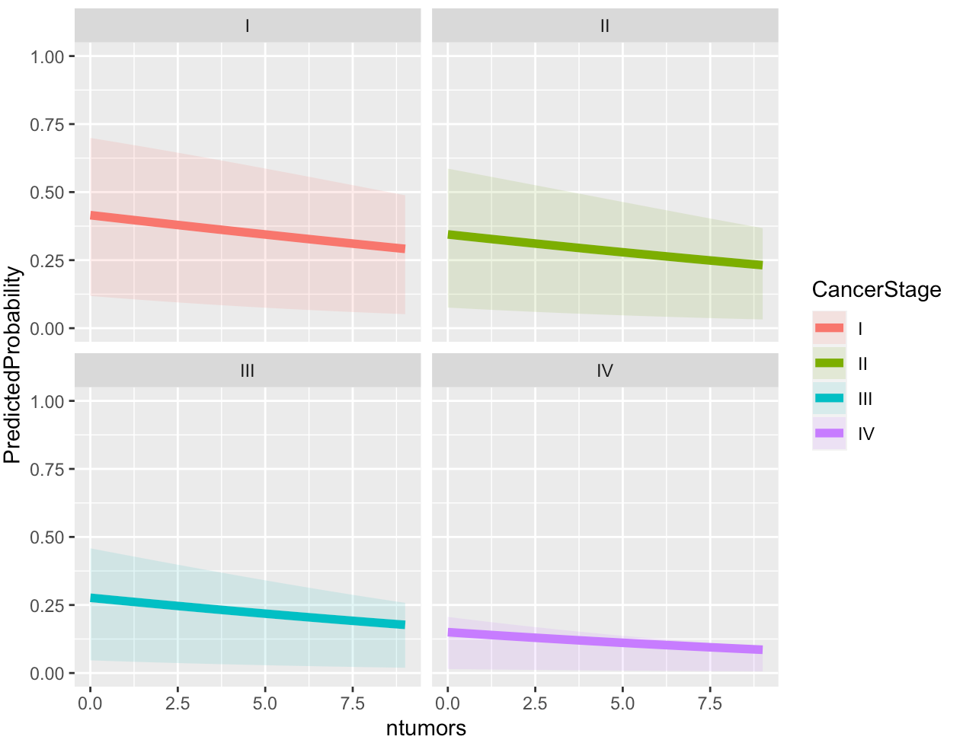
Marginal Effects
Converge rate:
CancerstageⅠ
>
Cancerstage Ⅱ
>
Cancerstage Ⅳ
>
Cancerstage Ⅲ

Slide 46
Summary
GLMM’s allow for greater flexibility in modeling non normal data, as various assumptions of linear mixed models can be deviated, and analysts may focus more on developing a model to fit the data rather than variable transformations.
This flexibility also presents challenges, as checking for various assumptions can be challenging and parameter estimation can be computationally expensive.
Appropriate interpretation of the link function and model results is important for analyzing model accuracy
Notes:
Maybe want to include results here?

Slide 47
Acknowledgements
https://stats.idre.ucla.edu/other/mult-pkg/introduction-to-generalized-linear-mixed-models/
https://cran.r-project.org/web/packages/margins/vignettes/Introduction.html#interpreting_interactions_with_marginal_effects
https://stats.idre.ucla.edu/r/codefragments/mesimulation/
https://www.theanalysisfactor.com/understanding-random-effects-in-mixed-models/
http://statweb.stanford.edu/~jtaylo/courses/stats203/notes/fixed+random.pdf
http://byrneslab.net/classes/biol607/readings/Bolker_et_al_2009_TREE.pdf
https://www.theanalysisfactor.com/regression-diagnostics-glmm/
https://pdfs.semanticscholar.org/4f1c/417fb9bac04309f0ba9b0ec44d5ef51e36aa.pdf

Slide 48
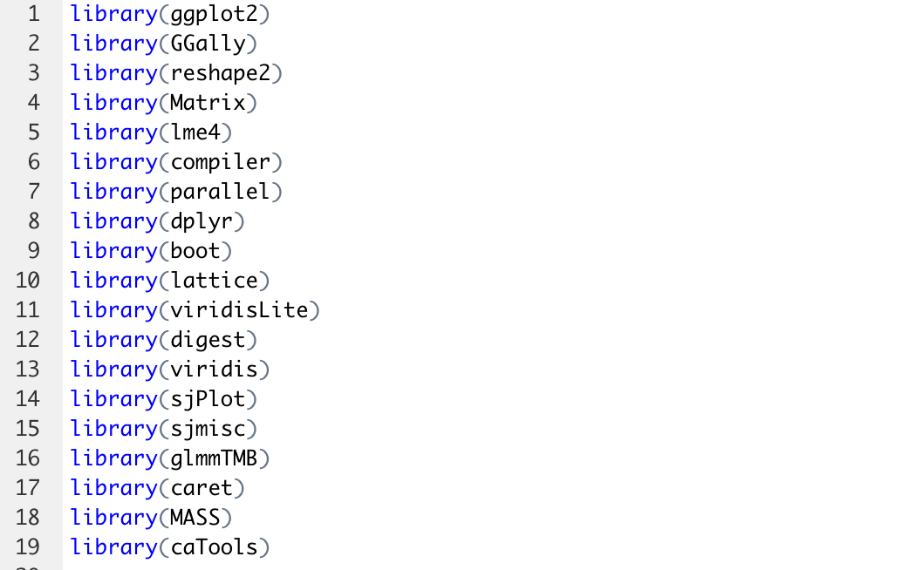
APPENDIX (code in R)
Notes:
Maybe want to include results here?

Slide 49
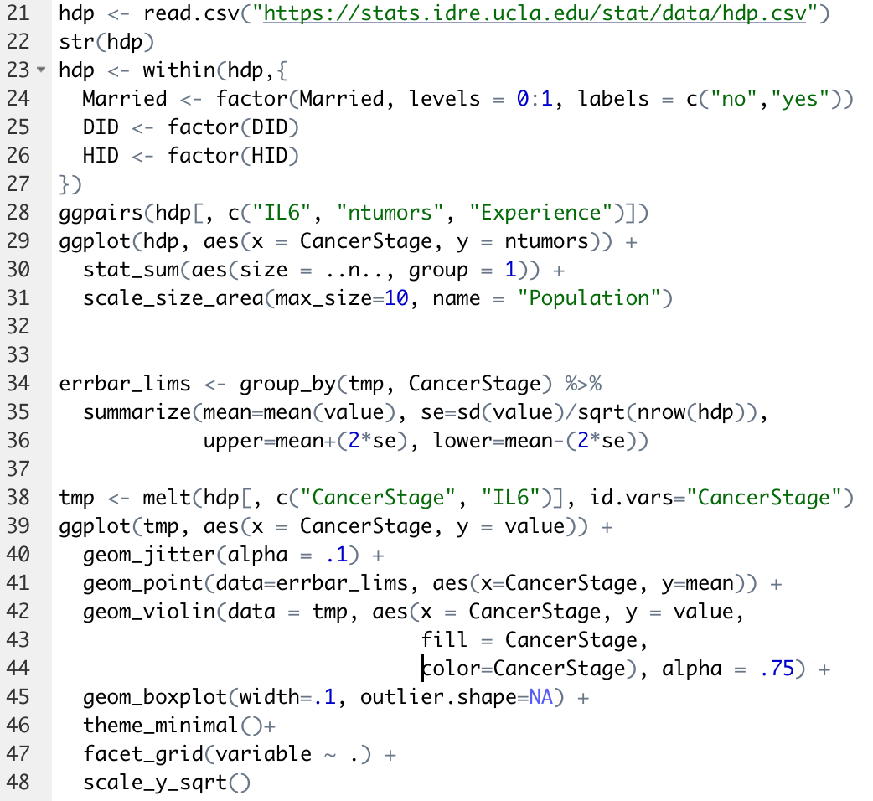
APPENDIX (code in R)
Notes:
Maybe want to include results here?

Slide 50
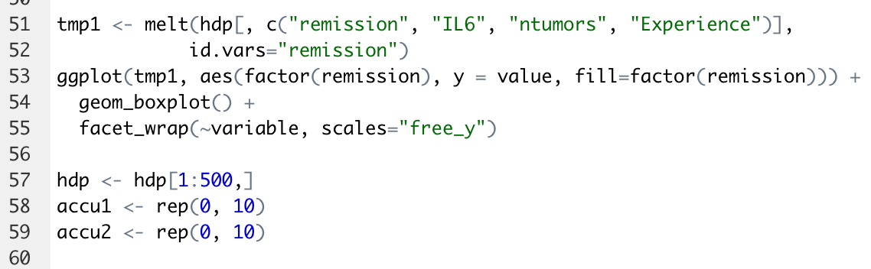
APPENDIX (code in R)
Notes:
Maybe want to include results here?

Slide 51
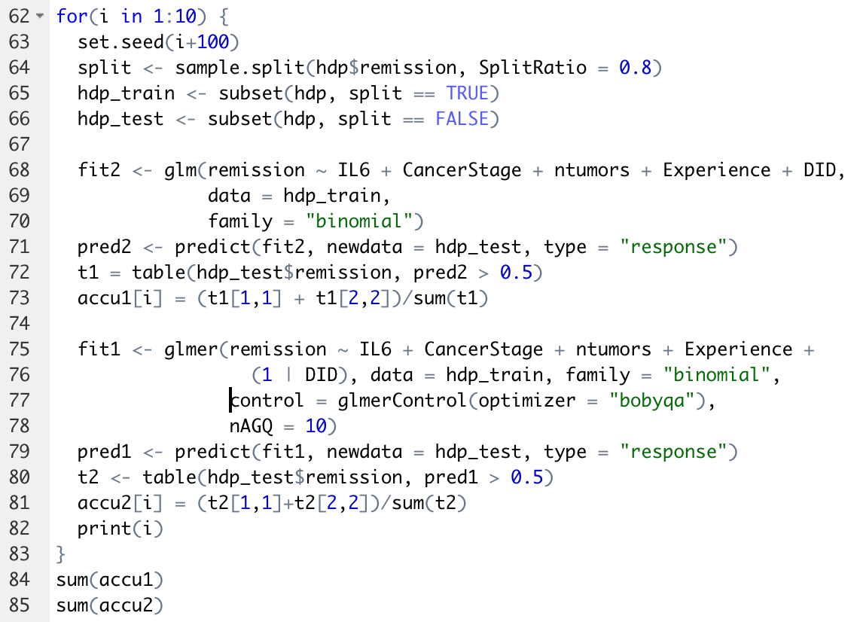
APPENDIX (code in R)
Notes:
Maybe want to include results here?

Slide 52
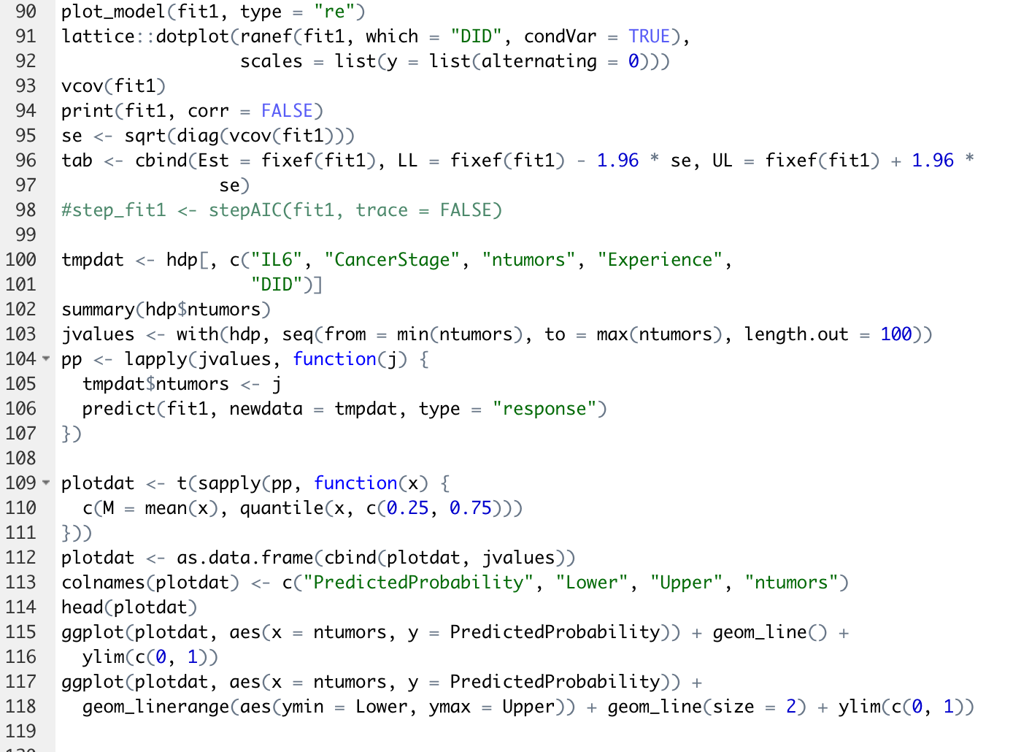
APPENDIX (code in R)
Notes:
Maybe want to include results here?

Slide 53
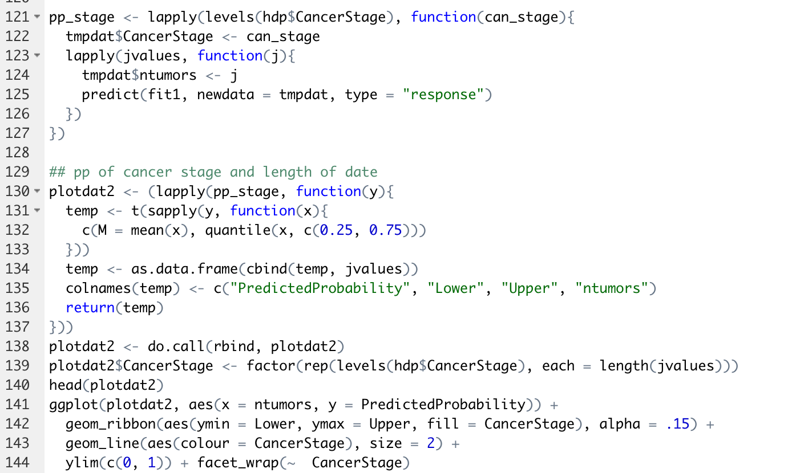
APPENDIX (code in R)
Notes:
Maybe want to include results here?

Slide 54
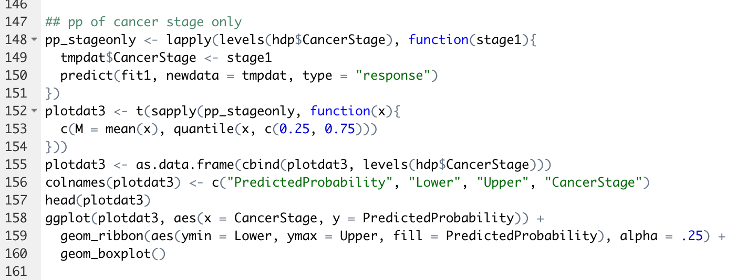
APPENDIX (code in R)
Notes:
Maybe want to include results here?

Slide 55
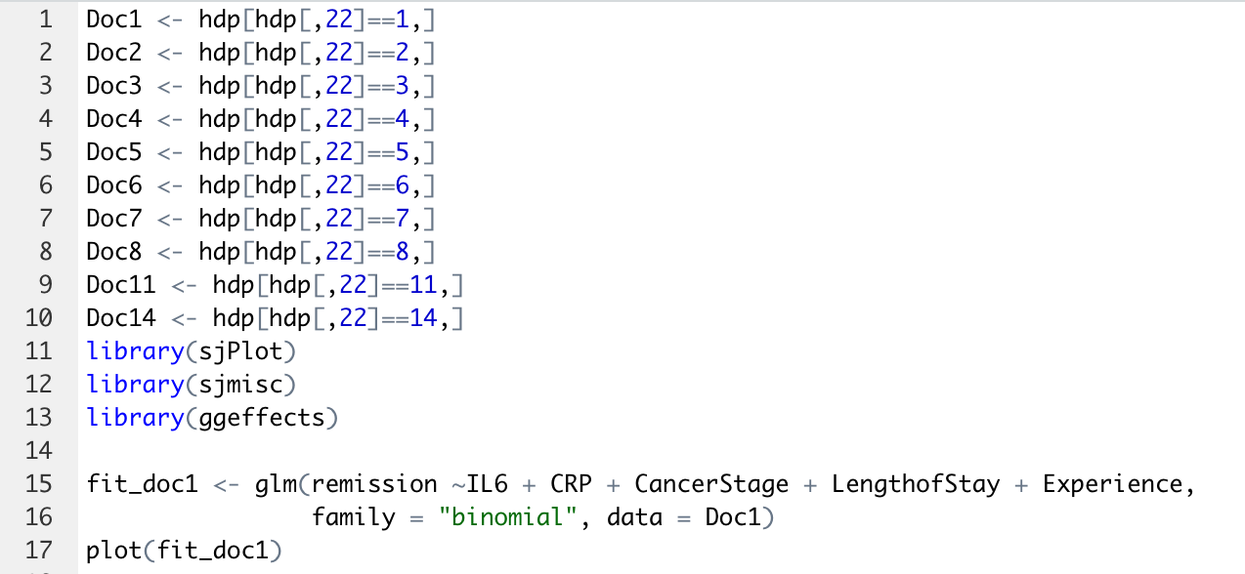
APPENDIX (code in R)
Notes:
Maybe want to include results here?

Slide 56
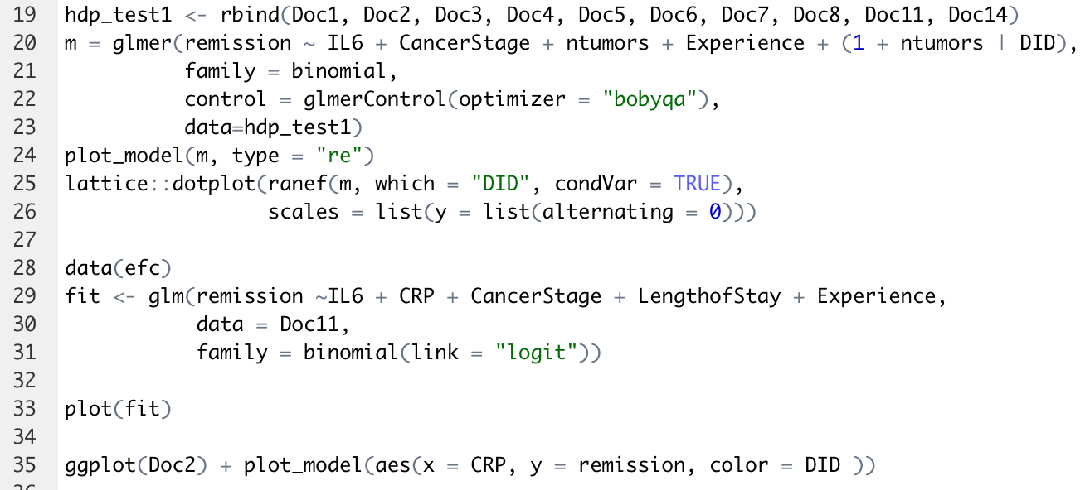
APPENDIX (code in R)
Notes:
Maybe want to include results here?

